Slide 1
The Effective Use of Business Analytics OR, THE FUTURE OF ANALYTICS IS HERE
South Central SAS Users’ Group
November 5, 2012
Philip Easterling
SAS Institute

Slide 2
Discussion Topics
Analytics versus “Business Intelligence”
Challenges to the use of Analytics
Role and Definition of Centers of Excellence
How to evaluate Analytics projects

Slide 3
THE ANALYTICS GAP
Many organizations:
Can’t always generate the information they need.
Can’t generate insight fast enough to act upon it.
Continue to incur huge costs due to uninformed decisions and misguided strategies.
The opportunities afforded by analytics have never been greater.

Slide 4
WHAT IF YOU COULD …
. . . predict the buying behavior and decision criteria of your prospects weeks before your competition?
. . . gain first-mover advantage by introducing new products and services to micro-segments that haven't been identified by competitors?
. . . evaluate the impact of your marketing campaigns hourly and make adjustments in real-time?
. . . improve customer experience scores that grow products per customer, reduce attrition, and leverage the power of customer recommendations for new business?
. . . predict likely failures of critical equipment and processes?

Slide 5
ANALYTICS – SAS DEFINITION
“Analytics” is probably one of the most nebulous, over-used terms in business today.
To some people, it can mean simple arithmetical calculations, such as those found in spreadsheets and reporting queries.
“Analytics” at SAS refers to the applied mathematical capabilities of SAS software which offer data-driven insight for better decisions.
There are different types of applied mathematics, so there is no “one size fits all” solution to the myriad business problems which require advanced analytics.
Analytics in SAS encompass a range of techniques for collecting, analyzing, and interpreting data in order to reveal patterns, anomalies, key variables, and relationships ( the “known unknown” and the “unknown unknown”).

Slide 6
“Analytics”
Common types of Applied Mathematics in Industry
Mathematical topics which analytical business consultants are unlikely to use
Types of applied mathematics with which analytical business consultants are likely to conduct projects
Types of statistical analysis and applications of statistics
Bayesian
Classical
Descriptive
Inferential
Predictive
Time series modeling
Quality control and process control
Survival analysis
Operations research and optimization
Text analytics

Slide 7
“analytics”
Descriptions of some types of mathematics which are commonly applied to Business problems
Type | Description
Simulation | Randomized repetitions of a network of discrete events in order to model real-world systems and phenomena (queues)
Optimization | Algorithm selects the best possible outcome, subject to satisfying system constraints
Matrix algebra | Calculations involving matrices solve multidimensional problems
Numerical methods | Use computers to iteratively calculate approximate solutions to calculus problems (common in engineering)
Fitting functions to data | Also called “curve fitting” by engineers
Predictive modeling | Fit statistical models to historical data in order to make predictions of future values
Survival analysis | Originally used by life scientists, but adopted by marketers and actuaries
Time series modeling | Special case when data are “auto-correlated,” such as time-dependent data (also called “Box Jenkins”)
Statistics
Classical | Descriptive: calculates metrics to characterize the distribution of values of data (mean, standard deviation, range, etc.) Inferential: involves drawing conclusions about relationships among variables in the data (including measures of correlation between variables) Predictive: involves studying historical data in order to make accurate predictions of future outcomes
Bayesian | Used to augment classical analysis when there is prior knowledge about how the data was generated

Slide 8
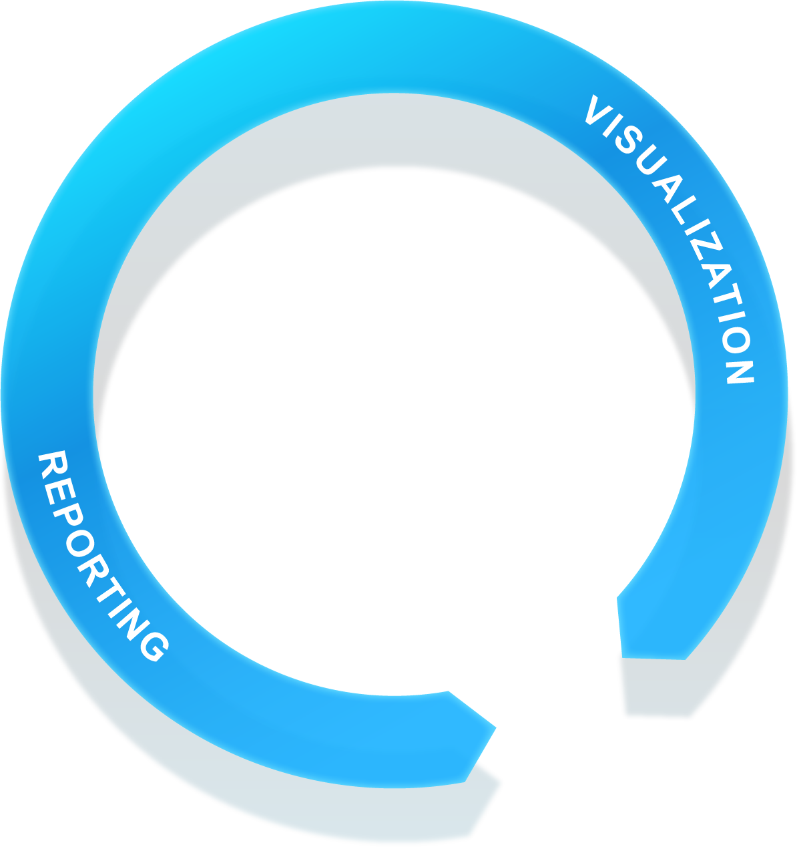
ANALYTICS – EXAMPLE APPLICATIONS
TEXT ANALYTICS
Finding treasures in unstructured data
like social media or survey tools
which could uncover insights
about consumer sentiment
FORECASTING
Leveraging historical time series data to provide better insights into decision-making about the future
INFORMATION MANAGEMENT
OPTIMIZATION
Analyze massive amounts of data in order to accurately identify decisions which are likely to produce the most
optimal results
DATA MINING
Mine transaction databases of records about spending patterns which indicate a stolen card
STATISTICS
Copyright © 2012, SAS Institute Inc. All rights reserved.
Notes:
Currently, most organizations use one or more of these techniques to solve a departmental-specific business problem. Even though this is valuable, this value is somewhat marginalized or not optimized when viewed from an enterprise standpoint. What we see is that departments, such as Marketing, Finance, or Risk, are using one technique to try to solve a problem but not multiple techniques, where necessary. So, for instance, in a bank, the risk department might use econometric forecasting to manage the treasury portfolio and overall risk ….. so they think. But, they are not actively looking at text (emails and chat) to see where the bank could be exposed. Or, a retailer might use forecasting to predict what items will sell, but they are not looking at online sentiment and customer segmentation to optimize what product they should offer what customer (and how to optimize distribution) all as part of the same process. These are examples of why these analytic techniques should be used together for the greater good.

Slide 9
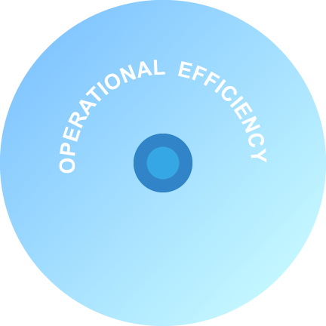
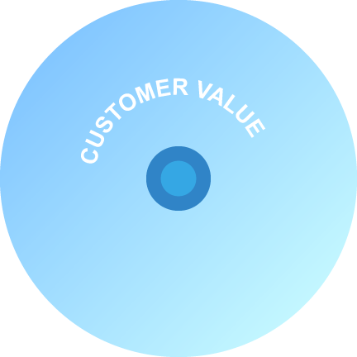
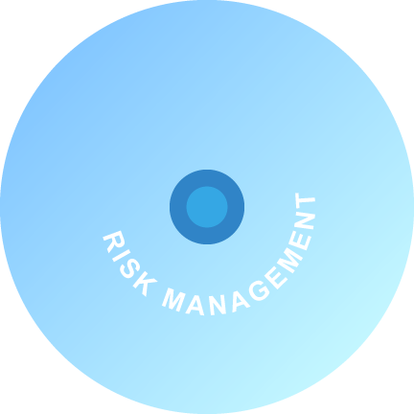
THE IMPACT OF ANALYTICS SPANS THE ENTIRE ORGANIZATION
Trusted, analytically-based decisions are needed across the organization.
Successful analytics are necessary in every business discipline: Planning, Research and Development, Marketing, Sales, Operations, Finance, Manufacturing, and Information Technology.

Slide 10
Analytics Projects
present challenges that other technology initiatives do not
The processes of building solutions and answering complex business questions are often less "linear," requiring much exploratory analysis and modeling in a somewhat iterative process
Even "canned" applications and toolsets may require special skills to implement and to use effectively
Advanced skills in statistics, econometrics, operations research, and/or computer science, and the expertise on their application to business problems, are often a constraint
Data from outside the organization may be needed (e.g., business partner, macroeconomic, demographic, survey, weather, government, trade association, etc.)

Slide 11
THE ANALYTICS LIFECYCLE
IDENTIFY /
FORMULATE
PROBLEM
BUSINESS
MANAGER
BUSINESS
ANALYST
EVALUATE /
MONITOR
RESULTS
DATA
PREPARATION
Domain Expert
Makes Decisions
Evaluates Processes and ROI
Data Exploration
Data Visualization
Report Creation
DEPLOY
MODEL
DATA
EXPLORATION
IT / SYSTEMS MANAGEMENT
DATA MINER /
STATISTICIAN
VALIDATE
MODEL
Model Validation
Model Deployment
Model Monitoring
Data Preparation
TRANSFORM
& SELECT
Exploratory Analysis
Descriptive Segmentation
Predictive Modeling
BUILD
MODEL

Slide 12
Current Trends in Analytics
Copyright © 2012, SAS Institute Inc. All rights reserved.
Notes:
New methods and techniques are being advanced from industry as well as academia. Solutions to complex problems often span multiple analytical disciplines and industry domains.

Slide 13
Current Trends in Analytics
Complex Business Problems Drive Analytics Innovation
Ongoing research to ensure that analysts have access to modern techniques which are robust and scalable
Innovative computational implementations of existing analytical methods
Creative applications of existing methods to solve new and different problems
Integration of methods from multiple disciplines to provide targeted solutions

Slide 14
Current Trends in Analytics
THE GROWING GAP IN AVAILABLE ANALYTICS TALENT IS DRIVING THE DEMOCRATIZATION OF ANALYTICS
Notes:
Increased adoption of analytics across an organization requires that analytic capabilities be put into the hands of a broader class of users (The Democratization of Analytics)
Due to the scarcity of high-end analytic talent and to the demand that analytics be leveraged more fully as part of the decision-making process, it is necessary to deploy analytical tools to business analysts as well as to statisticians and data scientists.

Slide 15
Current Trends in Analytics
THE GROWING GAP IN AVAILABLE ANALYTICS TALENT IS DRIVING THE DEMOCRATIZATION OF ANALYTICS
The demand for deep analytical talent in the United States could be 50 to 60 percent greater than its projected supply by 2018.
SUPPLY AND DEMAND OF DEEP ANALYTICAL TALENT BY 2018
140 - 190
440 - 490
180
30
300
50 - 60% gap relative to 2018 supply
THOUSAND PEOPLE
150
2008 employment
Graduates with deep analytical talent
Others ¹
2018 supply
Talent gap
2018 projected demand
Other supply drivers include attrition (-), immigration (+), and re-employing previously unemployed deep analytical talent (+).
SOURCE: US Bureau of Labor Statistics; US Census; Dun & Bradstreet; company interviews; McKinsey Global Institute analysis
¹
Notes:
Increased adoption of analytics across an organization requires that analytic capabilities be put into the hands of a broader class of users (The Democratization of Analytics)
Due to the scarcity of high-end analytic talent and to the demand that analytics be leveraged more fully as part of the decision-making process, it is necessary to deploy analytical tools to business analysts as well as to statisticians and data scientists.

Slide 16
Current Trends in Analytics
LEVERAGE ANALYTICS TO UNLOCK THE INFORMATION CONTAINED IN UNSTRUCTURED DATA
Copyright © 2012, SAS Institute Inc. All rights reserved.
Notes:
Studies have shown that greater than 80% of an organization’s data can be unstructured data. In this competitive economic environment, it is critical for companies to be able to leverage analytics to unlock the information contained in unstructured data.
Unstructured data needs to be combined with structured data for analysis

Slide 17
CURRENT TRENDS IN ANALYTICS - BIG DATA
VOLUME
VARIETY
VELOCITY
DATA SIZE
VALUE
TODAY
THE FUTURE

Slide 18
Current Trends in Analytics
“Big Data” is RELATIVE, not ABSOLUTE
Big Data
(Noun)
When the volume, velocity, and variety of data exceeds an organization’s storage or computing capacity for accurate and timely decision-making
Notes:
"Big data" is a popular term generally used to acknowledge the exponential growth, availability, and use of information (both structured and unstructured). A lot has been written lately about the big data trend and how it will become a key basis of competition, innovation, and growth.
How does SAS define or view the term “Big Data?”
Big data is a relative term (and not an absolute term) - when an organization’s ability to handle, store, and analyze data (from a volume, variety, and velocity perspective) exceeds its current capacity (beyond its comfort zone), then it would qualify as having a “big data” problem.

Slide 19
Current Trends in Analytics
The Changing Information Technology Environment
Open Source
Hadoop
R
Infrastructure Technologies
Cloud Computing
Grid
In-Database
In-Memory
Mobile Devices
Information Management
Stream It, Score It, Store It

Slide 20
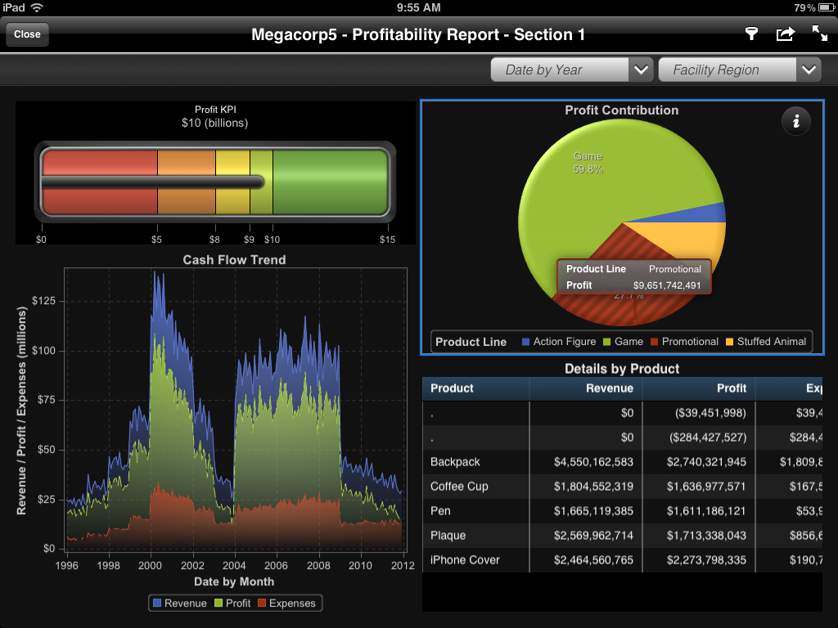
Notes:
SAS Visual Analytics is SAS’ native mobile application, allowing users to view their reports and dashboards on their selected device. The initial release of SAS Mobile included support for the iPad (Android support will be in the next release). SAS will monitor the market trends and the demand from customers for other operating systems like Windows and Blackberry and will provide support in future releases as required.
SAS Mobile provides adaptive presentation so that users do not have to create separate reports for each device type. With this offering, SAS Mobile provides all the required capabilities via a highly visual and interactive mobile application, backed by the centralized metadata security of an existing SAS Business Intelligence environment. While viewing the SAS Reports, the content will be downloaded to the device and thus fully support an interactive offline analysis.

Slide 21
Challenges to the use of analytics
Copyright © 2012, SAS Institute Inc. All rights reserved.
Notes:
New analytic methods and techniques are continually being advanced by industry as well as academia. Solutions to complex analytic problems often span multiple analytical disciplines and industry domains.

Slide 22
EXTERNAL VIEWPOINT
CHALLENGES IN ANALYTICS ADOPTION
Source: The Current State of Business Analytics: Where Do We Go From Here?
Prepared by Bloomberg Businessweek Research Services, 2011
Notes:
Here is an outside-in viewpoint from a 2011 Bloomberg Businessweek Research Report – “The Current State of Business Analytics: Where Do We Go From Here?”
Its key Message: Data, process, and people pose the three biggest challenges in getting business analytics right
Before achieving the effective use of business analytics, companies must take a hard look at their data management strategies.
Organizations are also constrained by a lack of integrated processes—operating within the department/functional unit level—which is a death knell to effective analytics across the organization
Copyright © 2011, SAS Institute Inc. All rights reserved.
22

Slide 23
Common observation and requirements
Information Challenges
Growth in external data, such as from social media sources
Complexity, access, and security
Data availability, quality, consistency, and format
Alignment with changing business requirements
Human resources, such as Analytical, Domain, IT Staff, etc.
Enterprise architecture, master data management (MDM), and governance
Infrastructure scalability, reliability, and cost

Slide 24
Common observation AND requirements
Organizational Challenges
“We invested so much in technology and other resources”
“The business return is not directly visible or quantifiable”
“We have difficulties in balancing operational, tactical, and strategic priorities”
“We lack a 360°view of our customers”
“We have too many repetitive processes”
“We have different competing priorities”
“We need to strengthen our competitive advantage”

Slide 25
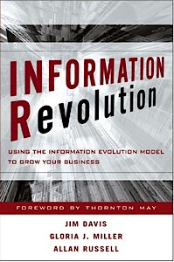
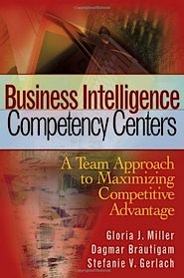
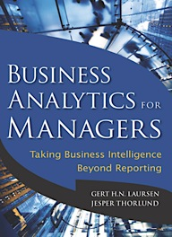
Information for Overcoming Challenges
SAS Research and Publications
Organizational Assessment and Alignment
Initial Framework for Centers of Excellence
Business Analytics for Decision Making

Slide 26
Organizational Dimensions
Key to Alignment
Business Analytics Skills and Resources
Organizational Culture
Well-defined set of processes to identify, rank, and address analytical requirements
Understand, value, and demand fact-based decisions strategies
Information Environment and Infrastructure
Relevant, accurate, consistent, and timely enterprise information
Training and career advancement to attract and retain talent
Internal Processes
Mature and capable enterprise information infrastructure
Coordinate support from IT, analytical resources, and computing power
Communicate the value of analytics, fund staffing, and reward proper use
Analytical, technical, and interpersonal skills
Notes:
Have a plan to address and overcome the challenges.
Copyright © 2011, SAS Institute Inc. All rights reserved.
26

Slide 27
Organizational Dimensions
THE Journey Toward the Target
Change from a “Project” to a ”Program” mentality
Change from a “Tactical” to a “Strategic” approach
Provide business and IT with shared ownership of the enterprise information environment
“Enterprise centers of excellence should support the effort …”

Slide 28
Organizational Dimensions
THE Journey Toward the Target
An executive vision and commitment to demand an information-driven organization and culture
Focus upon key organizational dimensions
Human capital
Internal information processes
Technical infrastructure
Organizational culture
Continual alignment with business objectives
Supported by an enterprise analytics Center of Excellence

Slide 29
THE Role and definition of centers of excellence
Copyright © 2012, SAS Institute Inc. All rights reserved.
Notes:
Centers of Excellence are also called Analytic Competency Centers.

Slide 30
What is a Business Analytics Center of Excellence?
An internal strategic team of analytics experts …..
with a specific mission to facilitate and promote the use of analytics …..
to achieve business objectives across the enterprise.
It can be its own department, a virtual department, or a combination of both.

Slide 31
Centers of excellence Characteristics
Sponsored by the executive team
Includes IT, business domain expertise, and analytic expertise
Has a well defined charter, responsibilities, and processes
Collaborates with ALL appropriate stakeholders
Strives to make analytics a repeatable and accessible process
Emphasizes the implementation of successful analytic applications

Slide 32
A Center of Excellence will enable the organization to:
Develop and evolve the Business Analytics infrastructure
Promote collaboration and leading practices
Achieve better results (growth, cost reduction, profitability, service effectiveness, quality improvement, etc.)

Slide 33
Evaluating Analytical Projects
Copyright © 2012, SAS Institute Inc. All rights reserved.

Slide 34
Evaluating Analytic Projects
Assessment
Gap Analysis
Recommendation and Development
Ongoing Support
Notes:
There are two critical questions at the very beginning: whose life will this change, and by how much?
Have the courage to say no: evaluate best-case analysis versus worst-case analysis versus no analysis.
Take a broad view of what constitutes analytics; prefer modeling over models, and prefer solutions over toolsets.
Work closely with supervisory and executive management in selecting and scheduling projects:
Identify where the demand for analytic resources exceeds the supply of analytic resources.
Develop a hierarchy of project types to help to set priorities.
Negotiate with executives for a reasonable project load:
To ensure quality of the analyses.
To allow for professional and personal growth.
Adopt a comprehensive approach:
Analysts participate in all phases from contracting and data to presentations and implementation.
Having at least two analysts work together on most projects helps with enthusiasm, ideas, and absences.
Encourage group brainstorming, but grant the team the power of the technical veto (which forces a team dialogue to address the issues).
Rotate analysts among different functional areas in order to gain a breadth of domain expertise.
Copyright © 2011, SAS Institute Inc. All rights reserved.
34

Slide 35
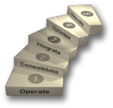
Analytic Approach and Methodology
Assessment
Gap Analysis
Recommendation and Development
Ongoing Support
Understand the vision, business objectives, and priorities of the executive team
Assess the current environment and capabilities, including infrastructure, people, process, and culture, using the information evolution model
Optional: Benchmark current information maturity against competitors
Analyze desired capabilities versus current capabilities
Conduct a gap analysis between desired and current capabilities in each of the four organizational dimensions
Identify starting points
Develop detailed recommendations, initiatives, and a roadmap to achieve the desired capabilities
Identify potential analytics Center of Excellence role
Develop Center of Excellence details
Support business unit in the implementation and operation phase
Monitor and make adjustments if necessary
Provide enterprise best practices and lessons learned
Notes:
Copyright © 2011, SAS Institute Inc. All rights reserved.
35

Slide 36
SOME Guiding principles
Evaluating Analytical Projects
Choose projects with high business priorities
Potential outcomes should produce business value
Define success up front and how to measure it
Have the skills and resources to use analytics
Have integrated and consistent data available
Have enough historical data

Slide 37
Fact-based decision making requires the right technology, talent, processes, and culture.
TECHNOLOGY
FACT-BASED
CULTURE
BUSINESS PROCESS
PEOPLE

Slide 38
REVIEW OF Discussion Topics
Analytics versus “Business Intelligence”
Challenges to the use of Analytics
Role and Definition of Centers of Excellence
How to evaluate Analytics projects

Slide 39
Questions? Thank You For Attending The Effective Use of Business Analytics
South Central SAS Users’ Group
November 5, 2012
Philip.Easterling@sas.com
WWW.SAS.COM

